Slide 1

security
registration
Authentication
Authorization

Slide 2
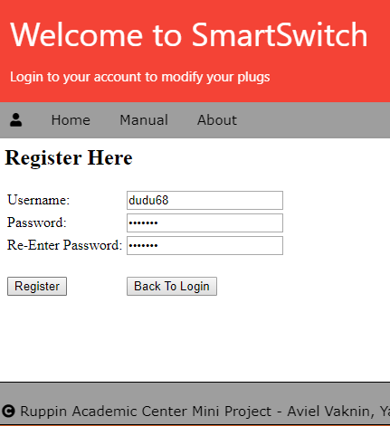
registration
Valid user name
Valid password
user data saved in server’s data base

Slide 3
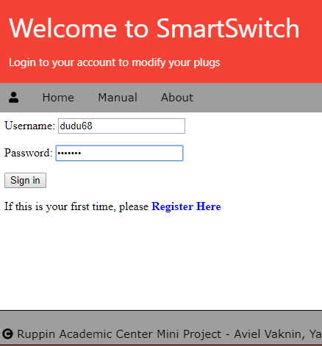
Sign in
Client user enter username & password
Server validate
Jwt token generation
Server & client keep the unique token string

Slide 4
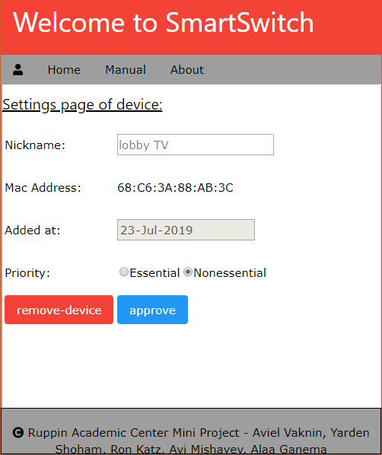
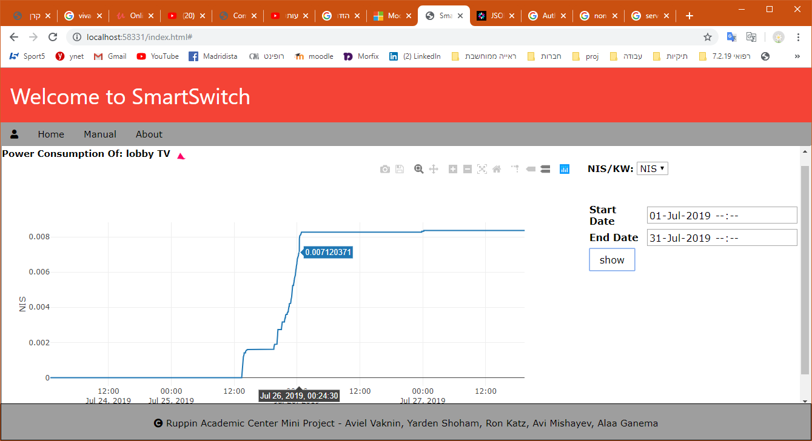
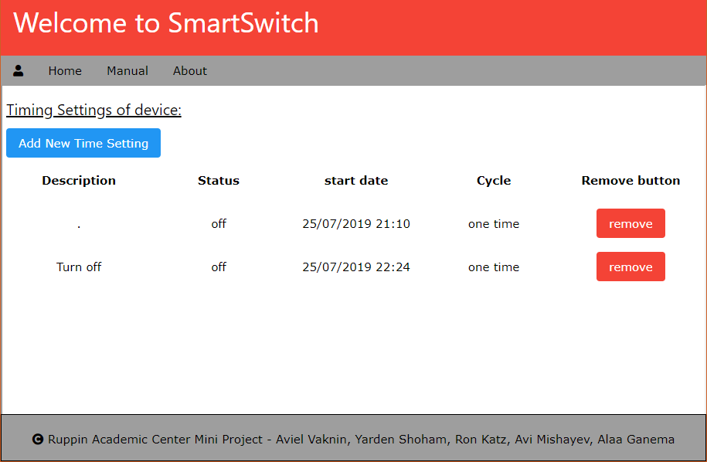
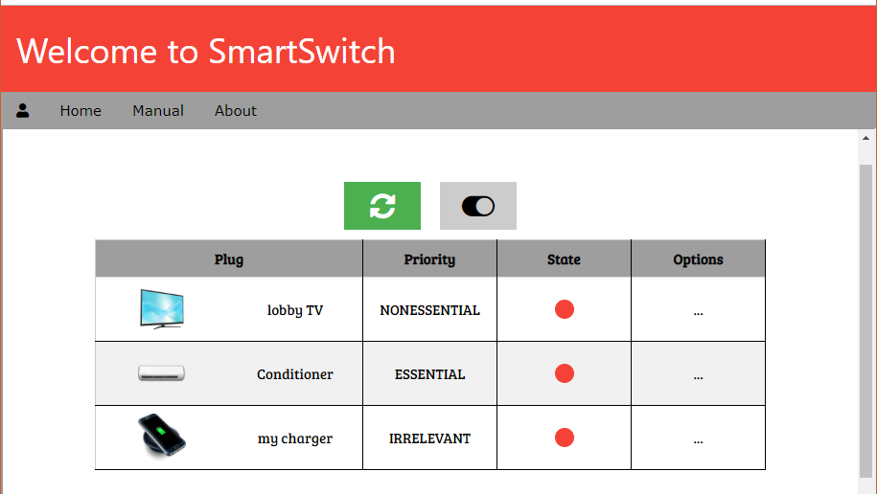
authorization

